Slide 1
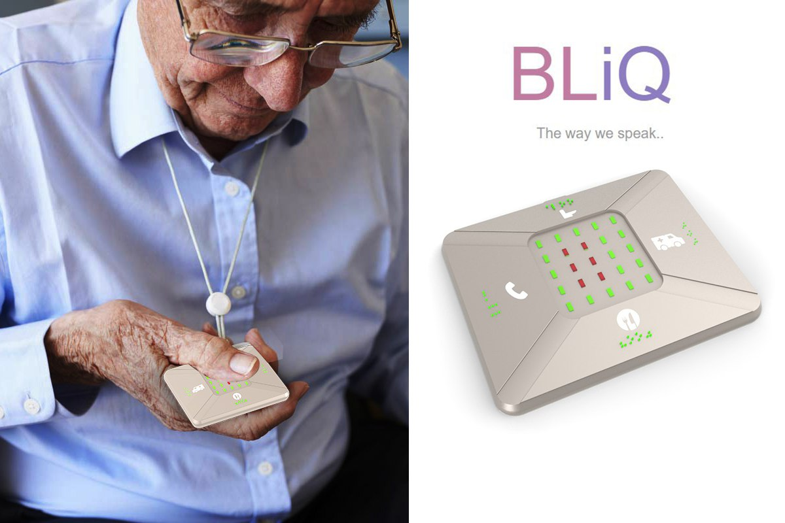
Team Foxlab

Slide 2
Monitoring and Assistive system For Deaf & Blind
What is BLiQ ?

Slide 3
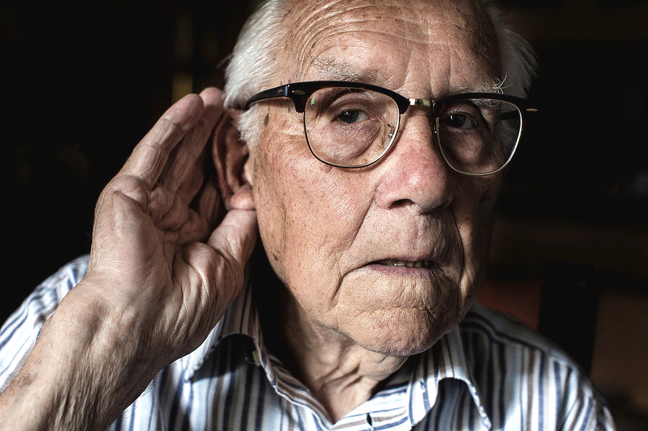

Slide 4
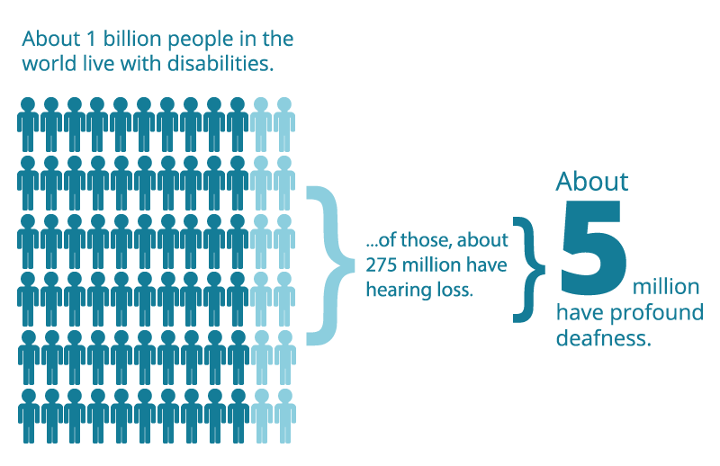

Slide 5
Problem Statement given by mada
Independent access
Independent information Interpretation
Low Literacy levels - Keep the deaf community in SILOS
5 % 466 Million (Source: WHO)

Slide 6
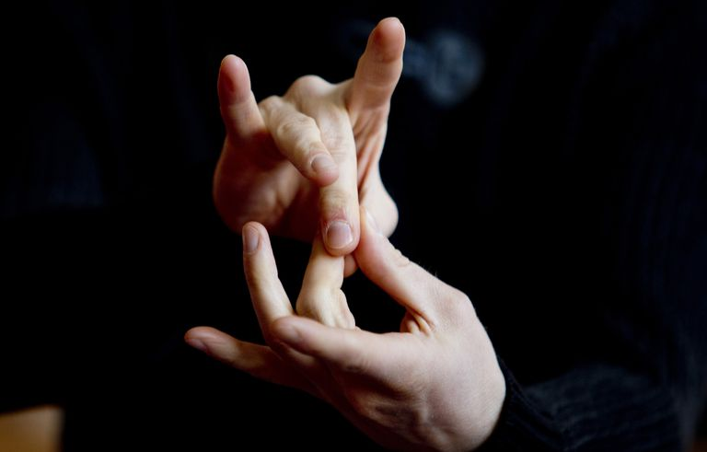
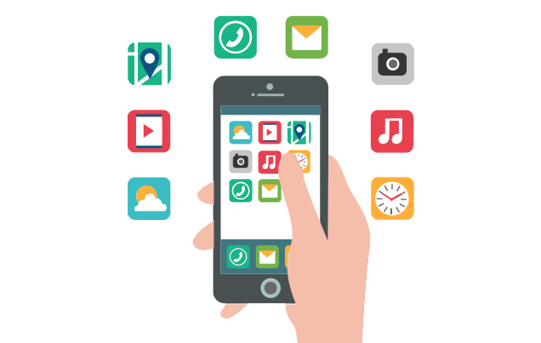
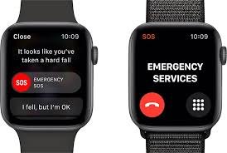
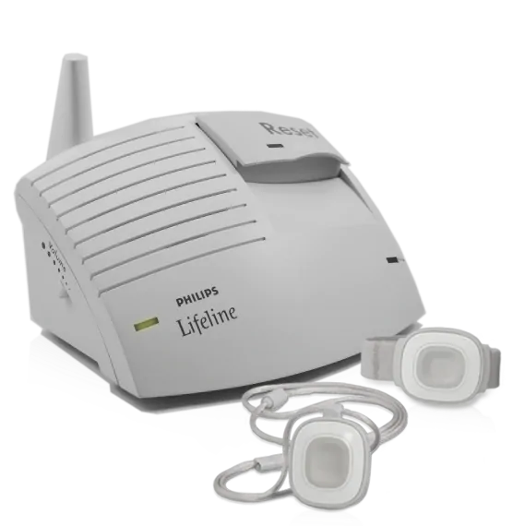
What's Existing solution ?
Sign Language
Mobile Apps
Smart Watches
Philips Lifeline

Slide 7
Constrained within community
GUI
Hard to use
GUI
Expensive
Not Customizable
Bulky installation
Feels like a patient already
Sign Language
Mobile Apps
Smart Watches
Philips Lifeline

Slide 8
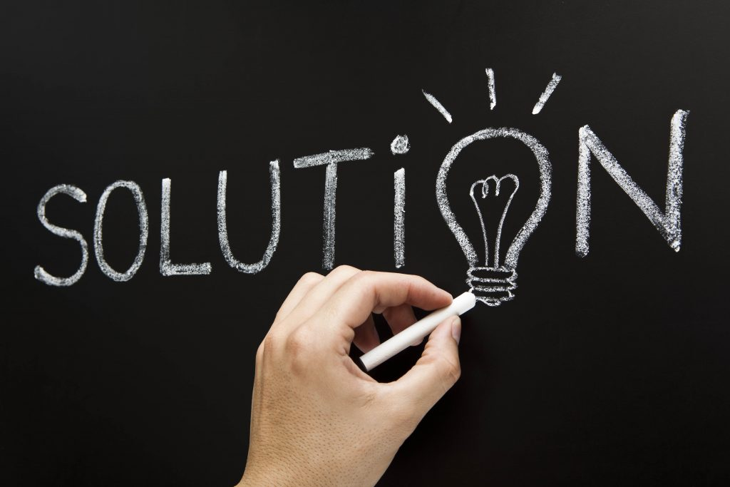

Slide 9
BLiQ Posses
Pendant IoT device
Mobile Application
Caretaker Device

Slide 10
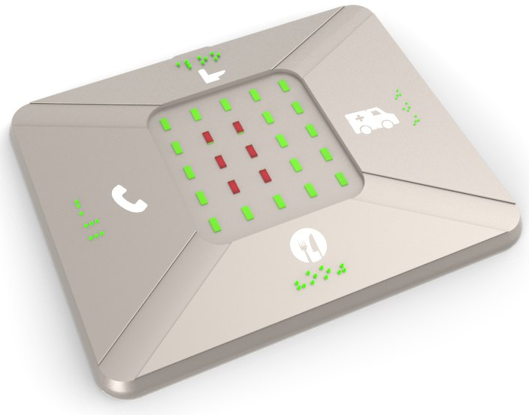
Pendant

Slide 11
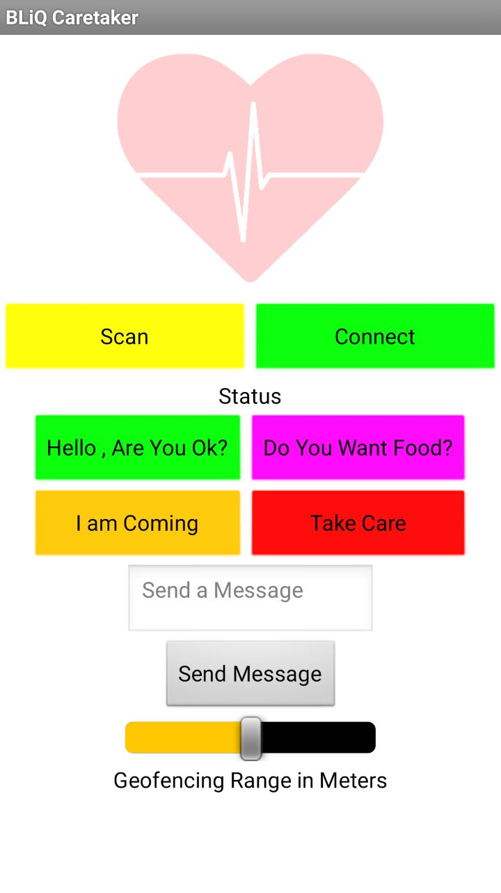
Mobile App

Slide 12
Care Taker Device

Slide 13
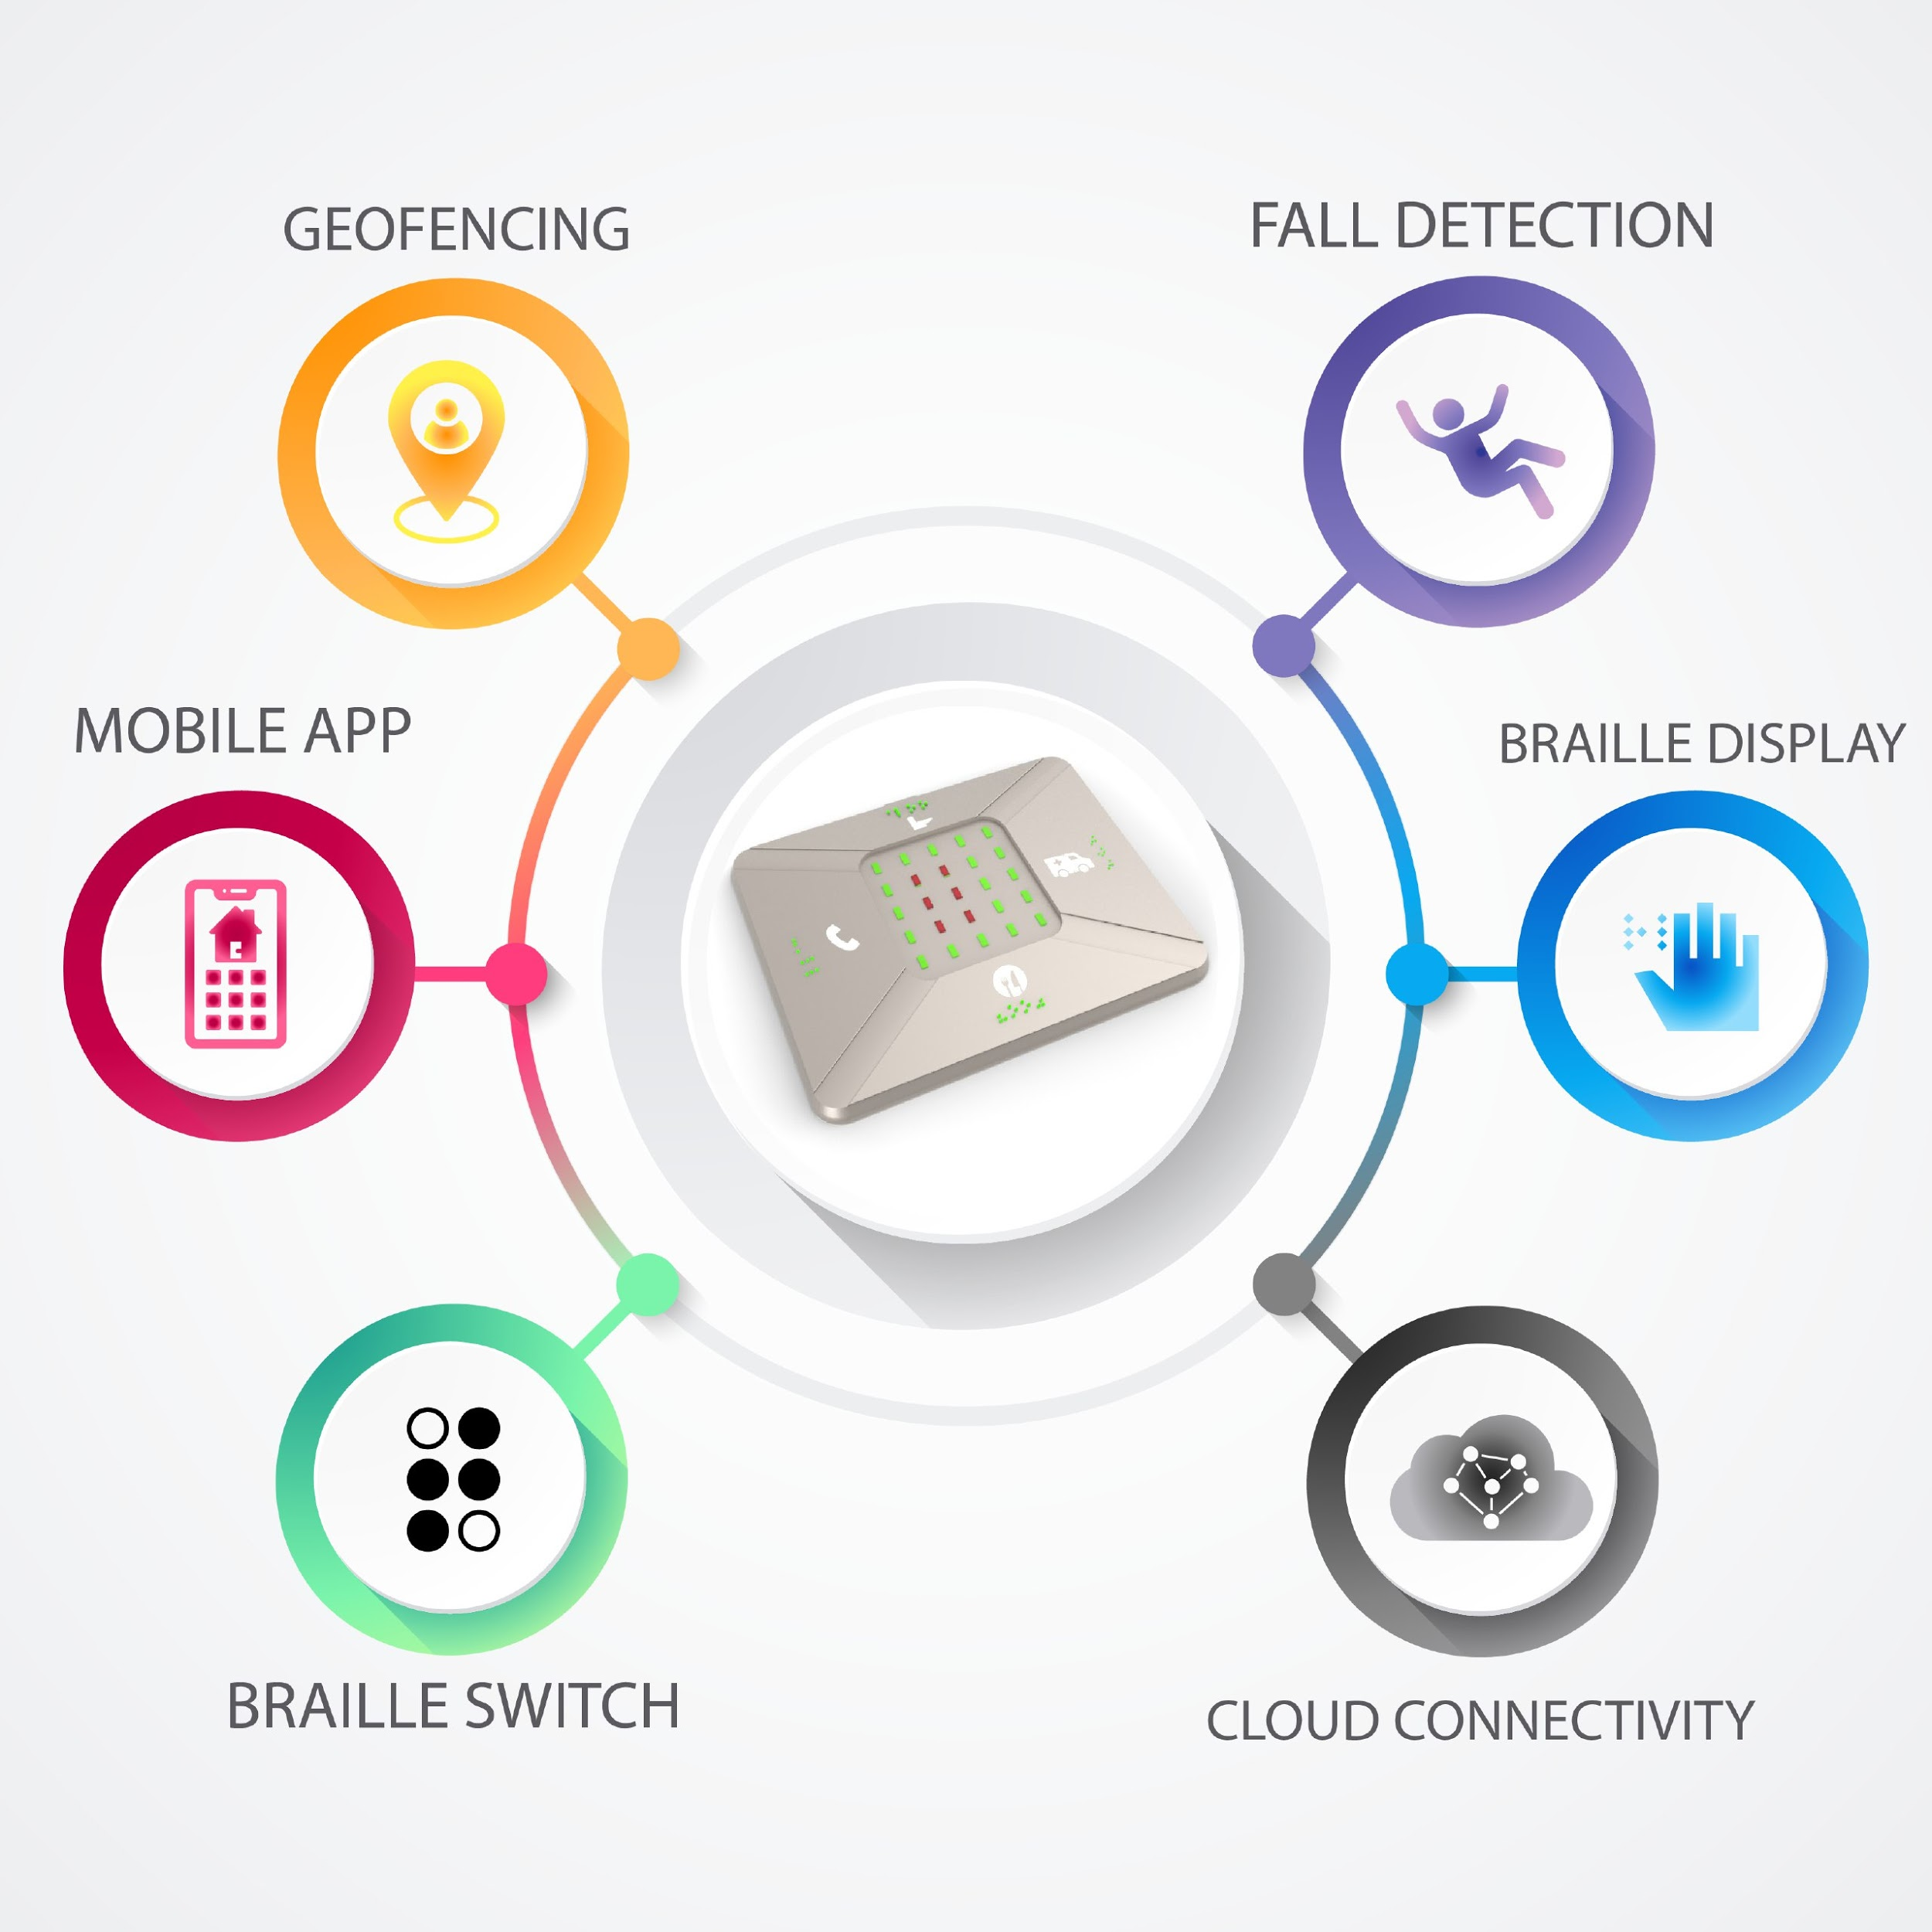

Slide 14
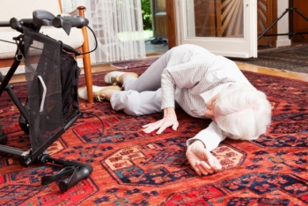
Fall Detection
Optimization for elderly deaf - Slow fall consideration

Slide 15
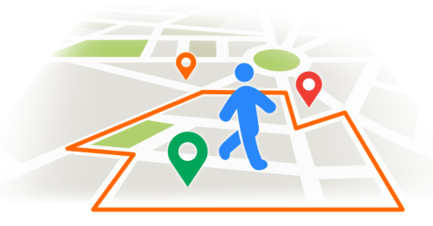
Geo-Fencing
Constrain within Location

Slide 16
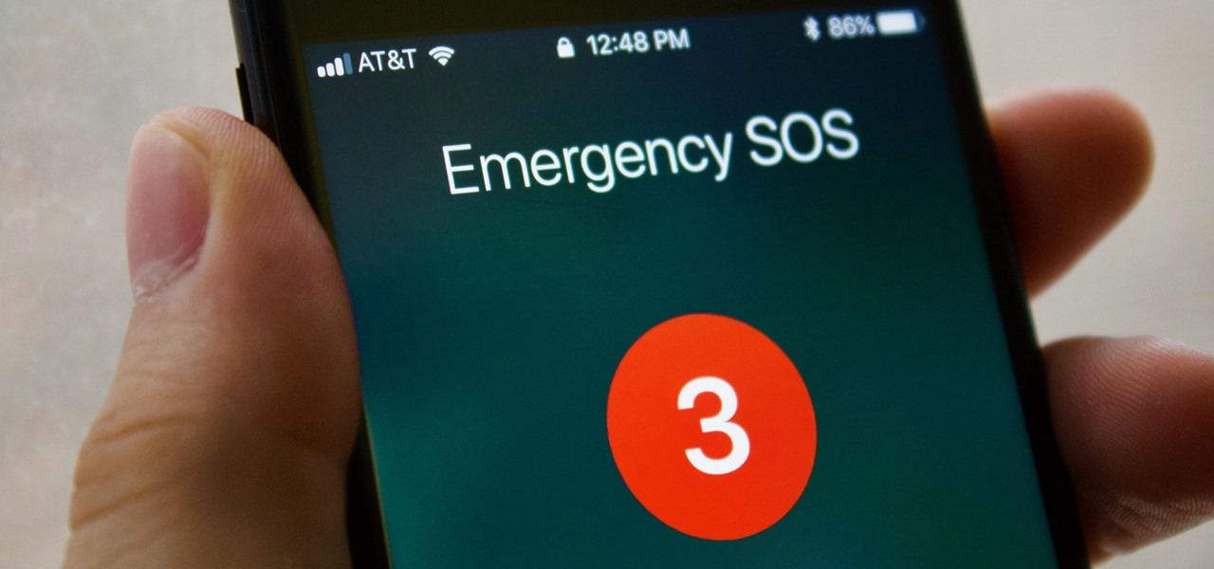
Emergency Button
Send emergency data with location

Slide 17
Functionalities
What is done
Independent interpretation for :
Daily Needs
SOS
Fall Detection and Monitoring
Braille Switches
Geo Fencing
TUI + Gestures (accessibility)
Yet to do.
Mode Switches
Electro impulse system
Offline - Push Notification

Slide 18
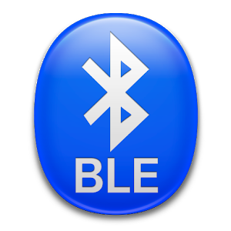
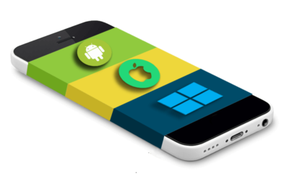
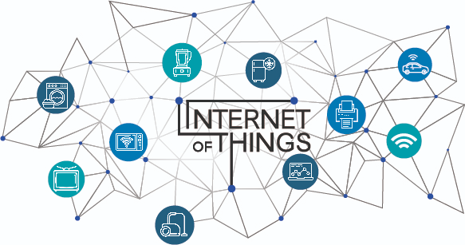

Technology used

Slide 19
Limitations - A Study
Limited no of switches - Since (Mode Switches)
Battery Life - Will last upto 2 month with watch battery

Slide 20
Target Audience
Deaf
Blind
Elderly care
Bedridden
Differently abled Children
Lifetime diseases- Parkinson's and seizures
Accident

Slide 21
Future Scope
Research Analytics with user consent
BLIQ 2.0 - Special device for Deaf advanced with multiple no of switches
Health Monitoring to IoT portal
Community Building - Volunteers
Emergency assistance
Meetings
Customizations
Hardware - Band, ring etc
Aesthetics
Material
Functionality

Slide 22
Home Automation Integration
GSM- even when offline push notification as SMS/Call
Smart City integration
Advanced Bidirectional communication

Slide 23
Technology Barriers - A Study
Size - Can be optimized with custom PCB
Material Used - Water repellent,Soft,Skin-like
Radiation - BLE , Cloud, IoT, Mobile bridge
Connectivity - Adding a GSM module will solve

Slide 24
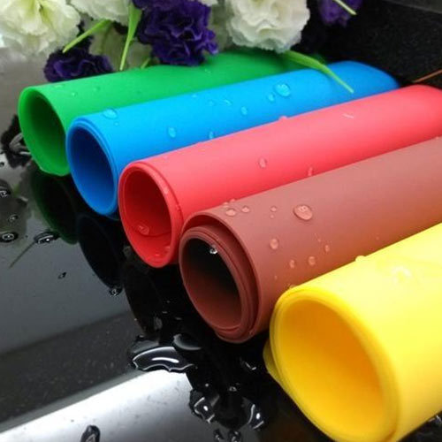
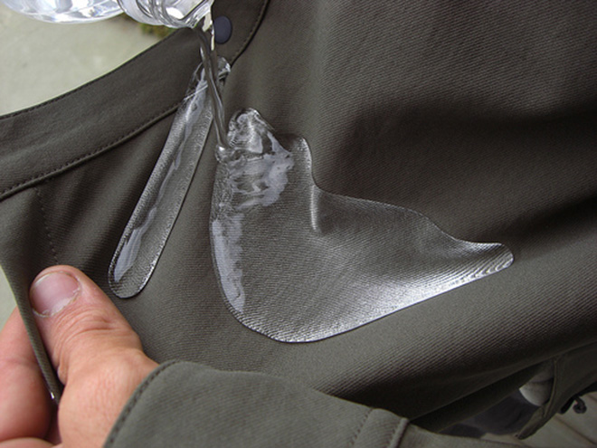
Material Used
Soft Silicon rubber - Like Skin Water repellent Microfiber cloth

Slide 25
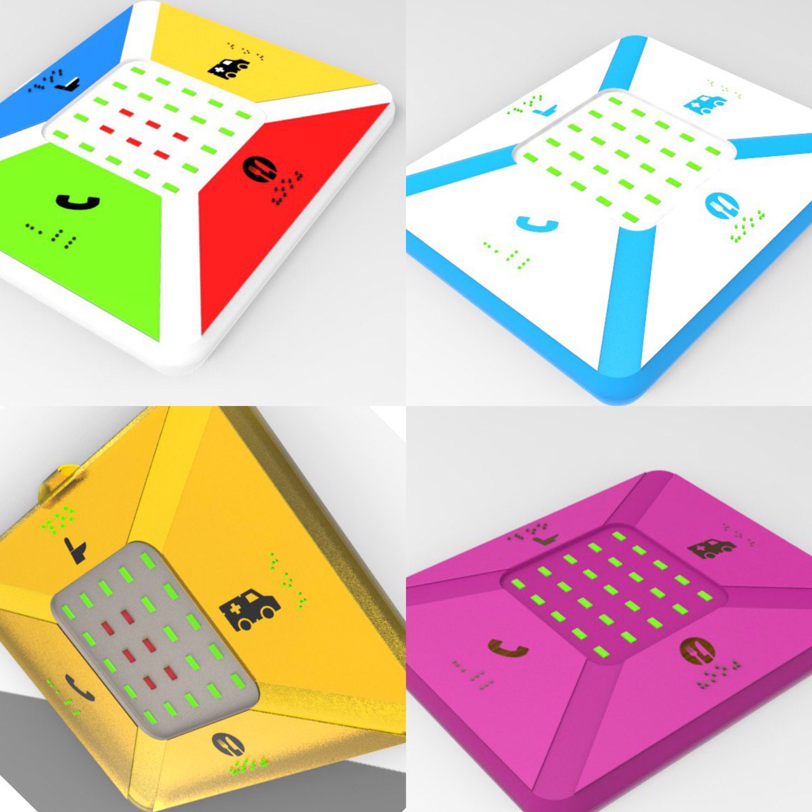

Slide 26
Business Plan
Manufacturing Cost | 200 QAR | USD
Over Head per device cost | 200 QAR | USD
Selling Price | QAR | USD
AMC | 250 QAR | USD
Margin Percent | 50 % + Recurring AMC

Slide 27
Customer Acquisition Models
Dealership
Direct Marketing
Government contracts

Slide 28
Timeline
2019, December
2019 Oct
Industrial Ready prototype
Started the initial research & Zeroth prototype @CODECAMP
2019, May
2020,February
First batch product on market commercially
100 product on market for user validation

Slide 29
Fund Requirement
3000 USD Industrial Prototype with Material testing - 1 month
15,000 USD for first 100 devices for user Validation - 3 Months
First Batch Product in Market, Final Iteration - 6 Months

Slide 30
What's very Next ?
Go to market Strategy
Device Testing & Validation
Optimization based on Customer Validation
100 Device in Market by April

Slide 31
Thank You..!

